Slide 1
NSU WEB TIME ENTRY
Rev. 9/21
Step by Step Guide to Entering and Submitting Electronic Timesheets
Non-Exempt Employees
Classified (CL), Unclassified Non-Exempt (UN), & University Police (PD)

Slide 2
Non-Exempt Employee Responsibilities
Non-Exempt Employees are:
Employees Must:
Report hours worked, comp/overtime worked, and/or leave taken
Submit a web timesheet for every pay period worked
All Payroll schedules are located on the Payroll website
Classified (CL)
Unclassified Non-Exempt (UN)
Submit all paper Request for Leave, Report of Compensatory Time/Overtime Earned, and any supporting documents to the Approver.
University Police (PD)

Slide 3
What is Web Time Entry
An electronic submittal of hours worked.
Access your timesheet via myNSU.
It is available 24 hours a day and 7 days a week.
Time can be entered at any time during the pay period.

Slide 4
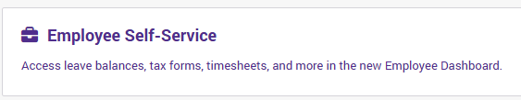
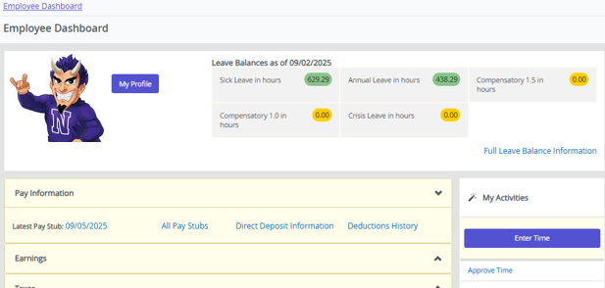
Accessing Your Timesheet
Log into myNSU.
Click Employee Self-Service to access the Employee Dashboard.
Click “Enter Time” in the My Activities section.

Slide 5
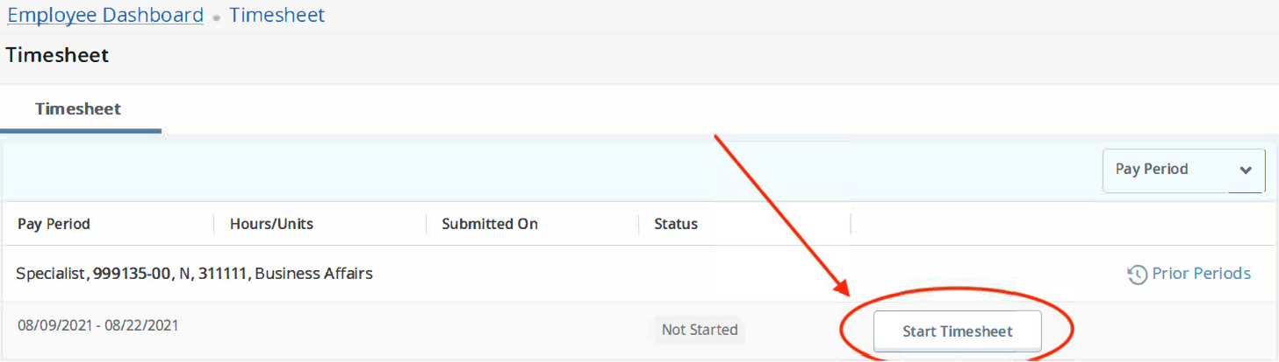
Start Your Timesheet
Click on “Start Timesheet” or “In Progress” for the period for which you are entering time.
*Status options are:
  Not Started
  In Progress
  Pending
  Returned for Correction
←Verify pay period dates

Slide 6
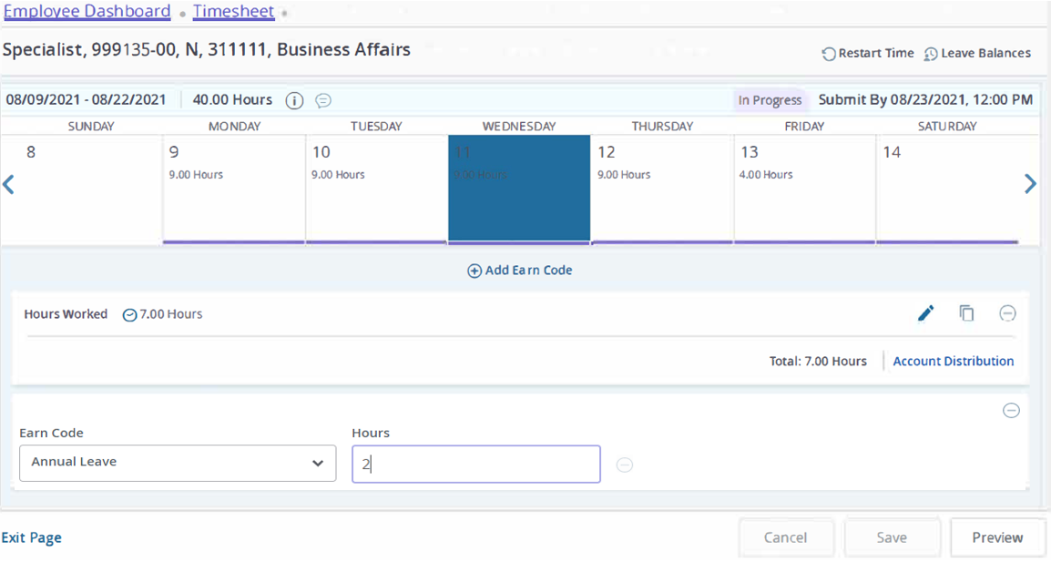
Enter Hours Worked, Leave Taken, and/or Comp/OT Worked
Select the appropriate date.
Click the Earn Code drop down menu and select the appropriate Earn Code to enter hours worked, leave taken, and/or time earned. *All Non-exempt employees must enter total Hours Worked for each day. This is regular hours physically worked, do not include leave hours or comp hours earned. *For all University Holidays, you must enter 8 (eight) hours in the Holiday Hours field.
Tab to the Hours field and enter the number of hours.
Click Save.
Click ⊕ Add Earn Code, to enter multiple earn codes. *Repeat the steps above for each day needs hours entered.
Ready to submit… See Preview and Submit for Approval
←Enter Hours

Slide 7

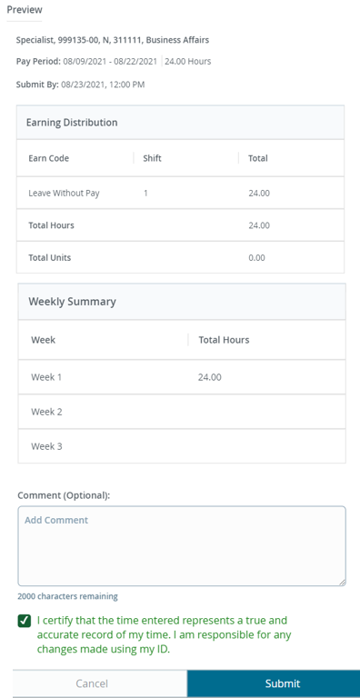
Preview and Submit for Approval
Preview
Submit for Approval
If the timesheet is correct,
Check (✓) the Certification check box, and
Click “Submit”.
Click the Preview to review your timesheet.
A summary of the hours entered is displayed.
*NOTE: CL & UN employee timesheets should total 80 + any ktime earned.
*If changes are needed, click the “X” to return to the entry screen.

Slide 8
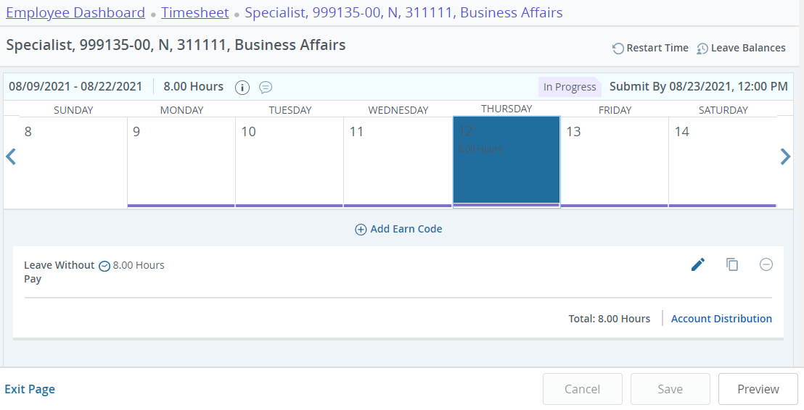
Edit Your Timesheet
The hours you entered will now appear on the calendar. Three options will appear next to the earn code entries allowing you to edit, copy or delete the entry for that day.
 Edit | If you would like to make changes to hours you entered, use the Edit icon to re-open the timesheet. Click Save.
 Copy | If you are entering the same number of hours for multiple dates, use the Copy icon. Select the hours to be copied by highlighting the days or copying from the first date entered to the end of the period. Click Save.
⊝ Delete | When you use the Delete icon, the system will ask you to confirm that you want to delete the hours. Click Save.

Slide 9
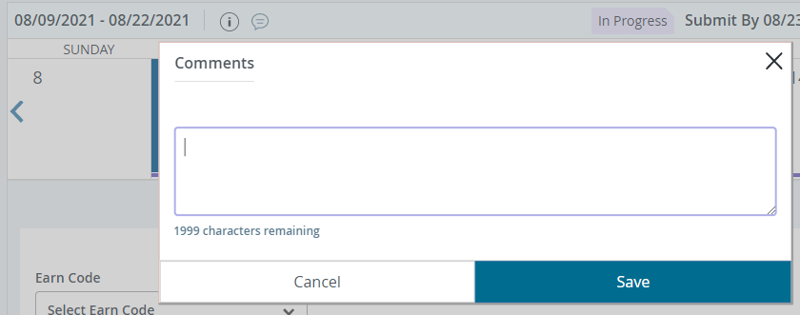
Comments (If needed)
Entering Comments:
Things to Remember:
Click the Comments icon to enter comments in the text box.
Click SAVE after entering the comment.
Comments should only be used to communicate posting time and attendance that did not meet payroll deadline.
Examples of Comments that may be entered:
Entered omitted leave from previous pay period in this pay period.
Sent corrections to HR/Payroll.
Never enter any personal information that should not be general knowledge.

Slide 10
Other Options
Restart
Click  Restart to remove all entries for the pay period.
Exit Without Submitting
Exit without submitting for approval.
This leaves the record in an “In Progress” status and is not submitted for approval.
Recall Timesheet
Click Recall Timesheet, if your timesheet has not been approved and you need to correct something.

